Slide 1
Cognizant and Aston Martin Formula 1 Gen-AI idea-thon
I / AM Pulse
Start your engine. Earn your experience
F1-nctional Intelligence:
Yash Sethi
Nehal Joshi
Sahil Negii
Damaris Arauco

Slide 2
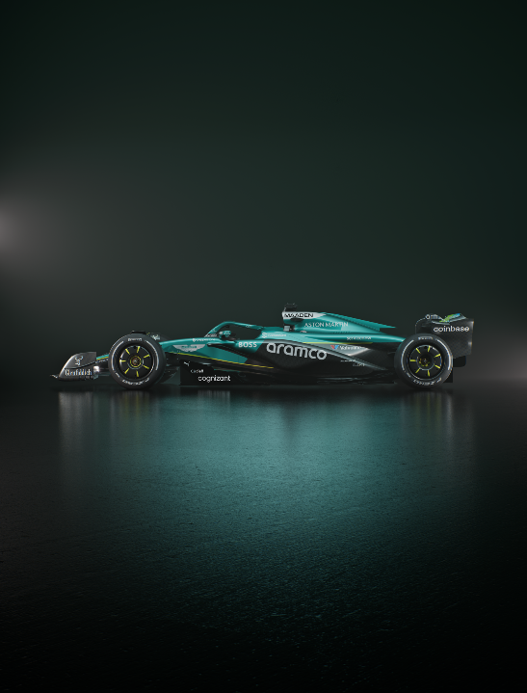

Agenda
The Challenge
Persona
I/AM Pulse
Engagement into Loyalty
Figma Demo
Social Activation Strategy
Business & Market Impact
Feasibility & Roadmap
Elevator Pitch

Slide 3
The challenge
How can AMF1 use Gen AI to meet fan expectations, boost merchandise sales, and strengthen its global brand through social media and lifestyle branding?
32
42%
1/3
1/3
Average fan age
of fans are female
joined in the last 5 years
of TV viewers are under 35
WITH MERCH ON THE RISE, AMF1 CAN ELEVATE FAN ENGAGEMENT BY REWARDING AND PERSONALIZING EXPERIENCES ACROSS DIGITAL AND TRACKSIDE TOUCHPOINTS.

Slide 4
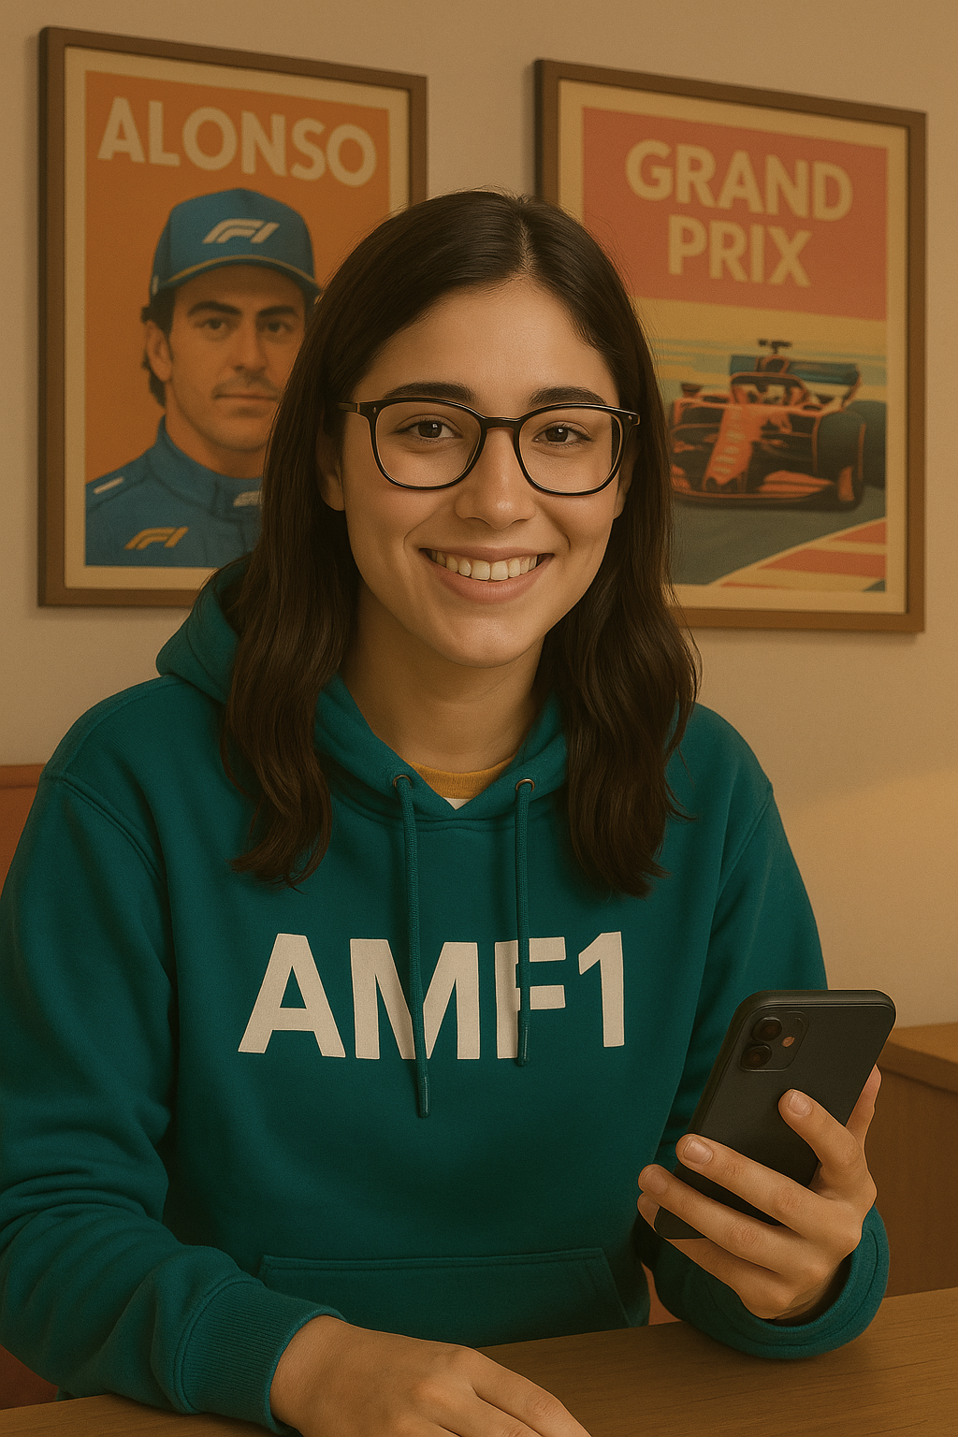
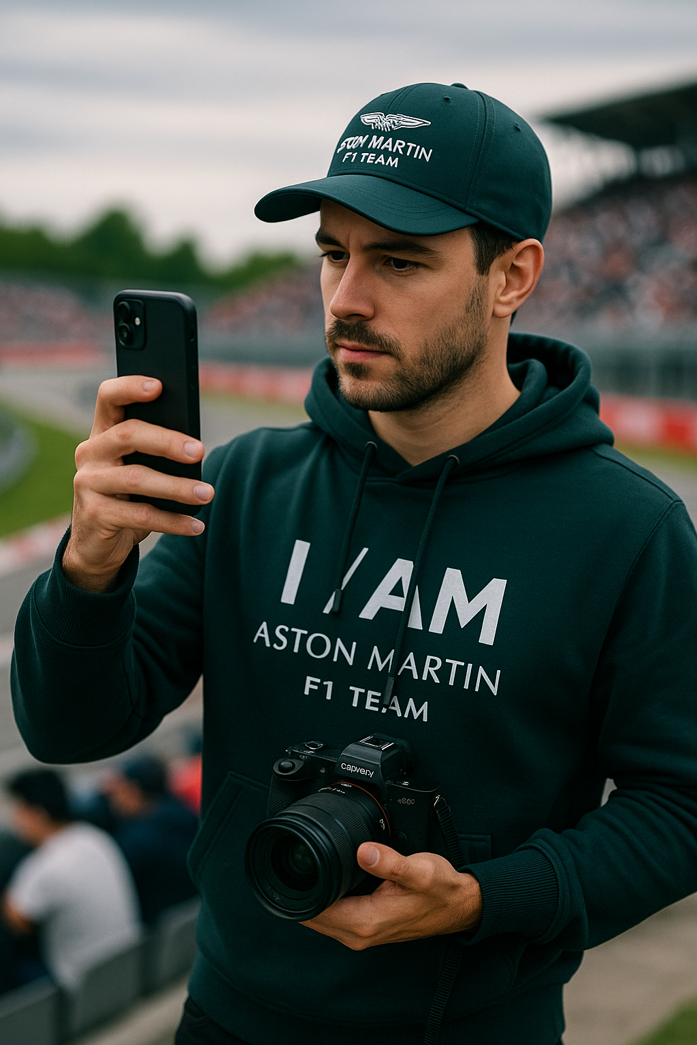
Two Fans, One Platform
REMOTE FAN
ON-SITE FAN
Name: Lucía
Age: 24
Location: Argentina
Follows AMF1 via: Instagram, Twitter (X), TikTok
Name: Julien
Age: 30
Location: Canada
Follows AMF1 via: Instagram, YouTube, TikTok
“I might be far from the track, but I never miss a moment”
“Being in the stands is electric. I just wish that energy lasted longer than one weekend”

Slide 5
Two Fans, One Platform
REMOTE FAN
ON-SITE FAN
Behaviors
Shares AMF1 edits on TikTok
Asks friends to bring back merch from abroad
Needs
Join exclusive remote events (raffles, online drops)
Ability to earn points for interacting with content
Frustrations
Rarely eligible for giveaways or exclusive merch
Experience feels made for trackside fans
What She’d Love
AR try-ons before buying
Forums and chats to connect with fans like her
Behaviors
Shares race-day content like stories, photo edits
Buys AMF1 merch at the track
Needs
Get something for attending, posting, or scanning QR codes at the track
Personalize his merch
Frustrations
Doesn’t feel rewarded for his loyalty or spending
Content doesn’t feel tailored to cities or attendance
What He’d Love
Montreal GP badges and a personal fan profile
Unlocking exclusive merch after attending a GP

Slide 6
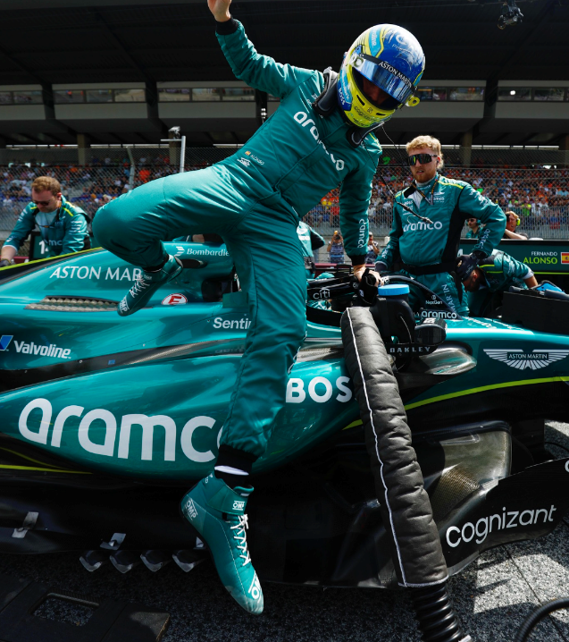
I/AM PULSE
Start your engine.
Earn your experience.
A fan-centric app that rewards every interaction — from quizzes to merch to race attendance — with personalized experiences, exclusive drops, and a sense of belonging.

Slide 7
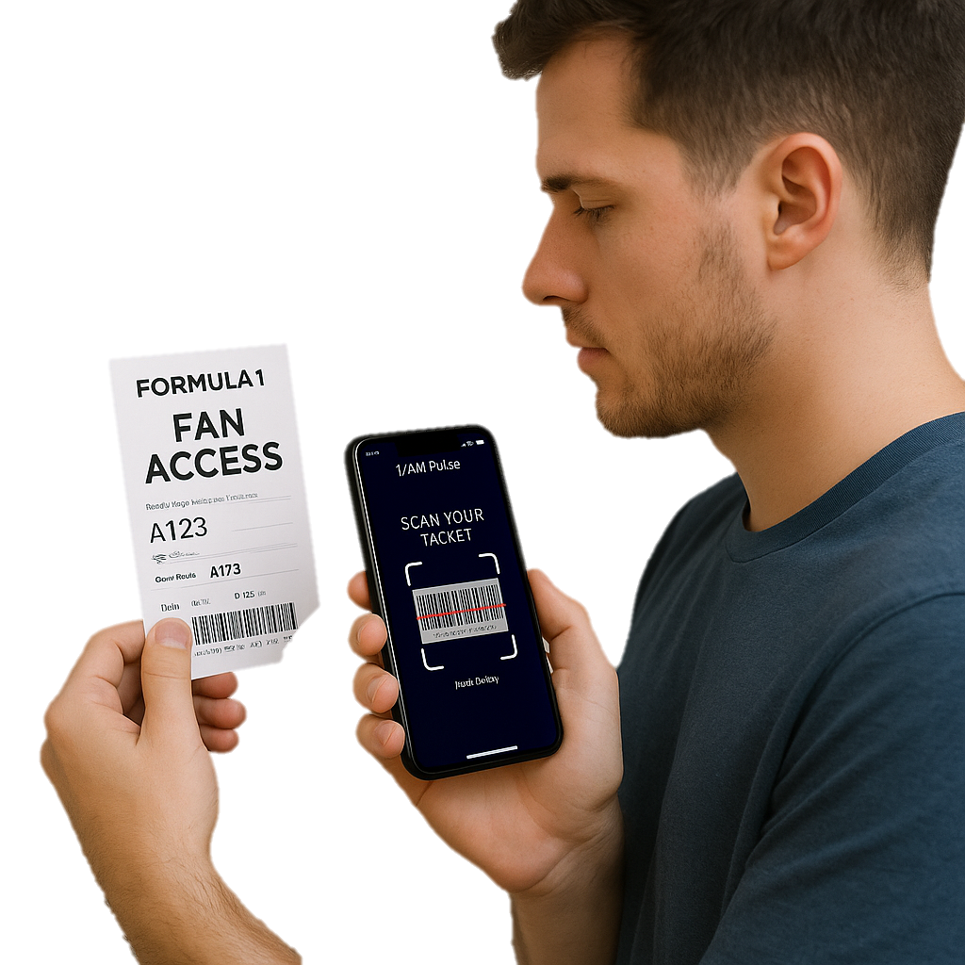
HOW IT WORKS
FANS CAN:
Register their tickets
Take in-app quizzes that reveal their interests
Engage with AMF1 content (watch, post, share)
IN RETURN:
Earn points
Unlock rewards like exclusive drops or fan meetups
Get personalized merch
Why this matters?
✅Feel recognized and included
✅Boost merch sales
✅Builds a community that lasts beyond race day

Slide 8
How I/AM Pulse Turns Engagement into Loyalty
INTERACTION
DATA COLLECTED
GEN AI INSIGHTS
POINTS EARNED
TAILORED REWARDS
Registering race tickets
Taking quizzes about interests
Sharing race-day content
Fan preferences
Event activity
Behaviour patterns across regions
AR try-ons before buying
Unlock trends across fan base
Suggest data-backed collabs
The more they participate, the more value they unlock
Fuel fan progression inside the app
Exclusive merch drops
Personalized items/content
Loot Crate
From clicks to cheers — every action fuels personalization

Slide 9
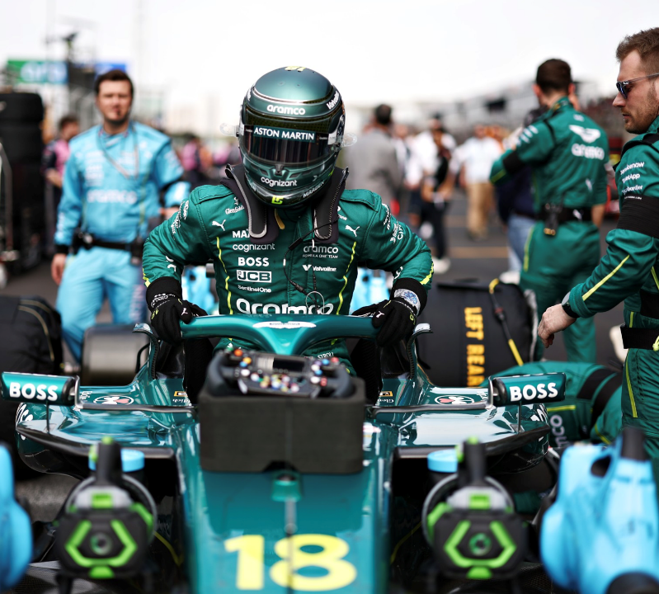

FIGMA DEMO

Slide 10
SOCIAL ACTIVATION STRATEGY
CATEGORY | HOW IT WORKS | EXAMPLE
Hyper-personalized campaigns | App quizzes reveal fan interests AI clusters fans and tailor social content | Pandora x AMF1 Capsule
Brand Ambassadors | Fans earn points for creating and sharing UGC Drives organic reach | “Post Your Fit” Campaign
Rewards & Activations | Engagement on social = Bonus points or early unlocks Connects in-app rewards with fan hype cycles | Montreal GP Fan Loot Crate
Activating fans with data-driven, shareable moments

Slide 11
Business & Market Impact
BUSINESS IMPACT
SUCCESS METRIC
Increase merch sales through exclusives
Increase merch sales through exclusives
Personalized bundles and product suggestions
Average Order Value (AOV)
increase per user
Monetize fan preferences through smarter brand collabs
Number of quizzes completed
% of users engaging with collab
Strengthen loyalty through gamified rewards and recognition
Points redeemed per user
Repeat logins / active users retention
Each point earned leads to stronger fans, smarter insights and higher revenue

Slide 12
FEASIBILITY & ROADMAP
FEATURES
KEY OUTCOME
RELEVANT TOOLS
PHASE 1:
MVP LAUNCH
Ticket registration
Fan interest quizzes
Special loyalty tier
Validate fan interest
Collect zero-party data
Typeform (quizzes)
Figma (protype)
PHASE 2:
FAN EXPERIENCE
AR try-on for merch
Fan forums
Exclusive drops
Increase engagement
Build emotional connection
8thWall (WebAR)
Discord (forums)
Shopify (exclusive drops)
PHASE 3:
FULL INTEGRATION
Personalized rewards
Social activation and brand collabs
Loyalty Tiers
Monetize fan engagement
Scale globally with data-driven loyalty
OpenAI (Gen AI personalization)
Instagram/TikTok APIs
All tools are existing and scalable, no need to build from scratch to bring it to life

Slide 13
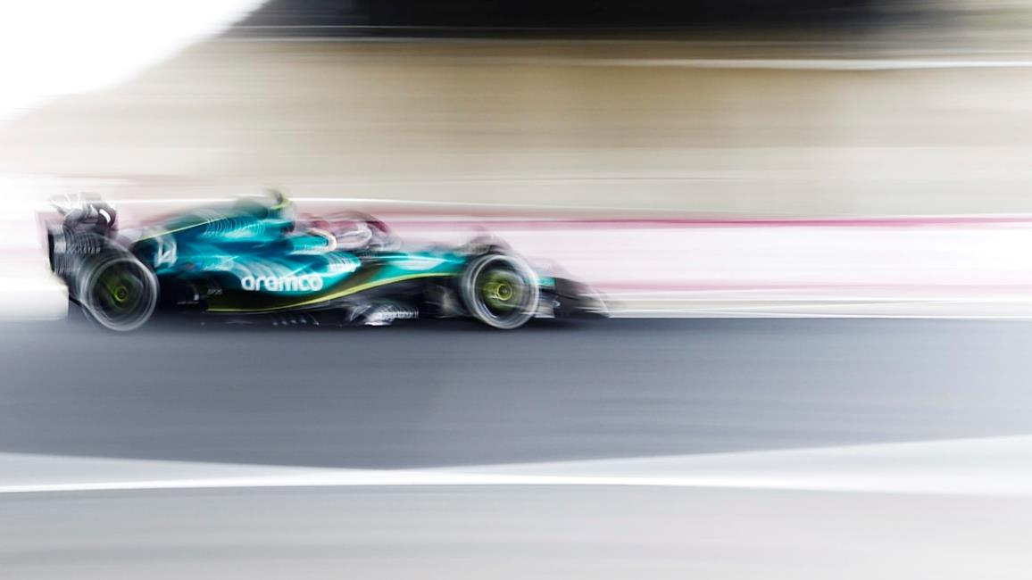
Elevator Pitch

Slide 14
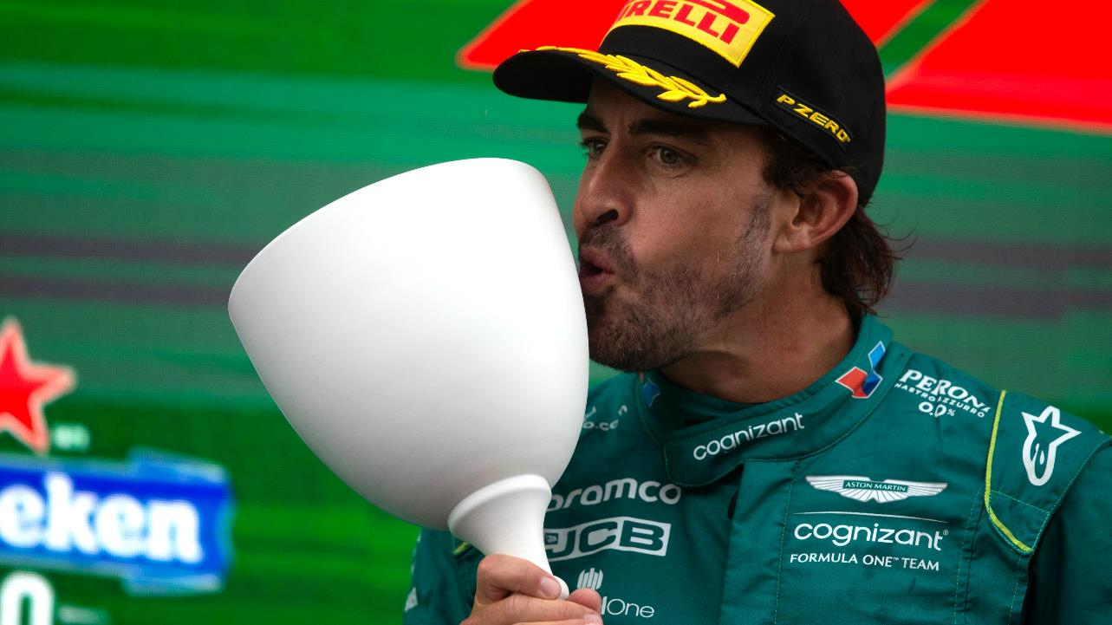
Q&A
Yash Sethi, Nehal Joshi, Sahil Negi, Damaris Arauco

Slide 15
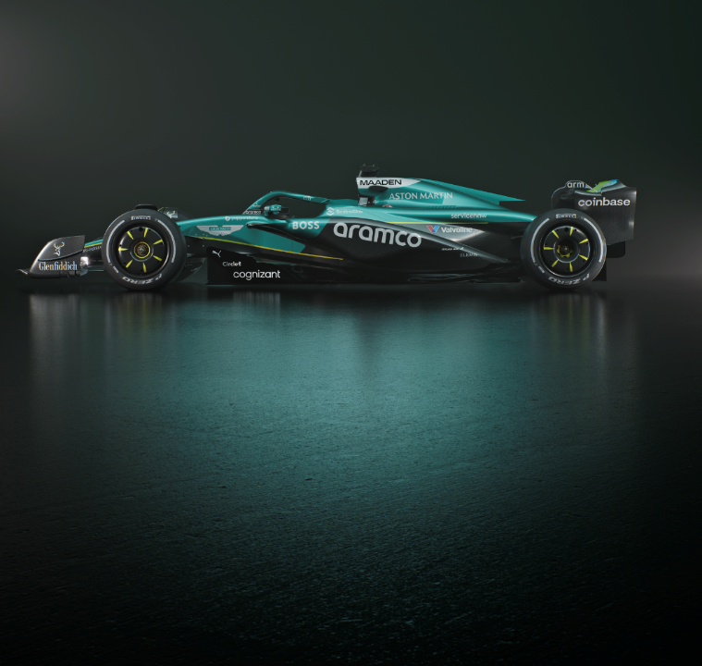
Click to add divider title, copy can go here on one or two lines

Slide 16
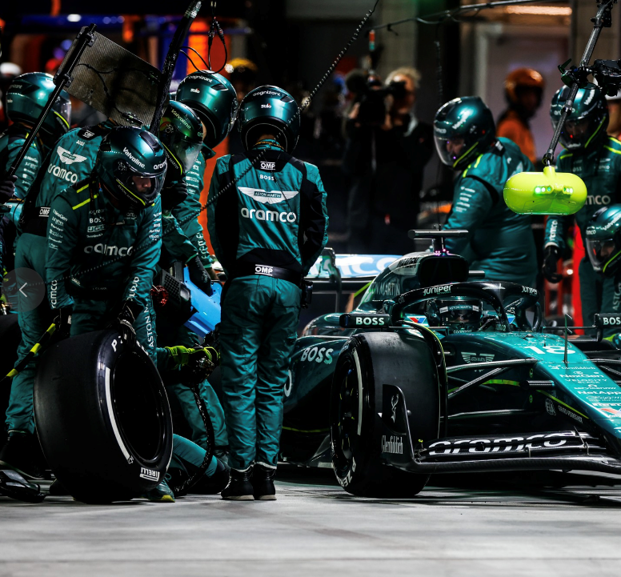
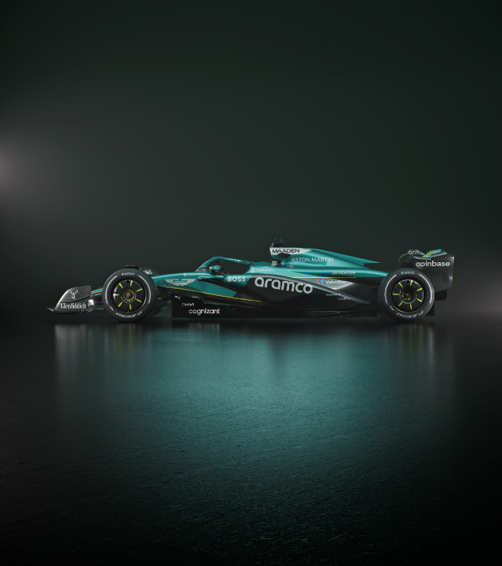
Benefits

Slide 17
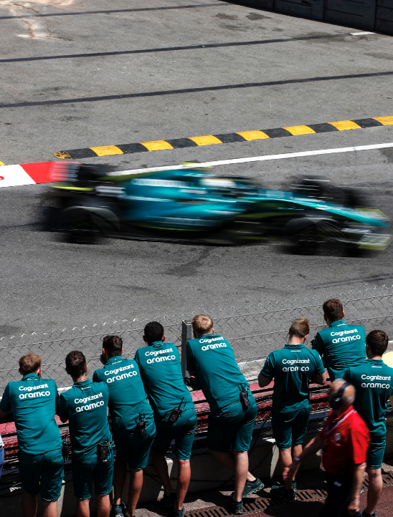
Agenda
ONE

